Slide 1

Academic Session 2025-26
Even Semester Jan-Jun’26
Apex Institute of Technology
Department of Artificial Intelligence and Machine Learning
System Design (23CST-390)
Faculty: (Er.) Kamaljeet Kaur (E19147)
DISCOVER . LEARN . EMPOWER
Lecture
Introduction to System Design

Slide 2
Learning Objectives
Understand the fundamental concepts of system design and its importance in building
scalable applications.
Learn the principles of scalability, availability, and reliability in large systems.
Differentiate between Monolithic and Microservices architectures.
Explain key performance metrics such as latency and throughput.
Understand how caching improves system speed and reduces load on backend services.

Slide 3
Course Outcomes
On completion of this course, the students shall be able to:-
CO1 | Understand the fundamental system design principles, including scalability, high availability, and fault tolerance, while analyzing how these core principles influence architectural decisions in real-world distributed environments.
CO2 | Apply various distributed architectural patterns, key database models (SQL and NoSQL), and critical communication protocols to evaluate their specific applications and trade-offs in modern system designs.
CO3 | Apply advanced scaling techniques, such as caching, load balancing, database sharding, and replication, to design system components that effectively handle massive user traffic and data volumes.
CO4 | Analyze the trade-offs between different system architectures, data storage solutions, and consistency models (like the CAP theorem) to select and justify optimized configurations for performance, cost, and reliability goals.
CO5 | Create and document comprehensive, end-to-end system designs that are inherently scalable, distributed, and fault-tolerant, leveraging modern paradigms such as cloud computing and microservices architecture.

Slide 4
Unit-1 Syllabus
Unit-1 | System Design
Introduction to System Design | Introduction to System Design, Functional & Non-Functional Requirements, Scaling Challenges, Load Balancing, Caching Strategies, Replication, Sharding.
Databases in System Design | Databases in System Design – SQL vs NoSQL, CAP Theorem, Distributed Databases, Consistency Models, Eventual Consistency, Distributed Caching (Redis, Memcached), High Availability, Fault Tolerance, Microservices vs Monolithic Architecture.

Slide 5
Introduction to Distributed Databases
A distributed database is a database that runs and stores data across multiple computers, as opposed to doing everything on a single machine.
Typically, distributed databases operate on two or more interconnected servers on a computer network.
Each location where a version of the database is running is often called an instance or a node.
A distributed database is basically a database that is not limited to one system, it is spread over different sites, i.e, on multiple computers or over a network of computers.
A distributed database system is located on various sites that don’t share physical components.

Slide 6
Applications / Uses of Distributed Database
It is used in Corporate Management Information System.
It is used in multimedia applications.
Used in Military’s control system, Hotel chains etc.
It is also used in manufacturing control system

Slide 7
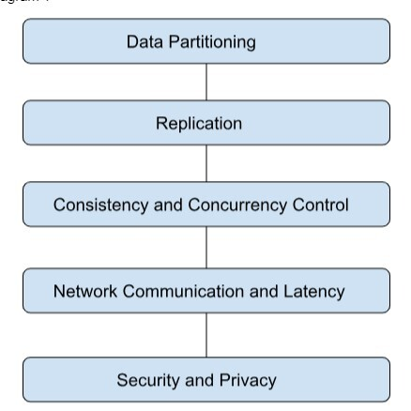
Distributed Database Types
There are two types of distributed databases:
Homogenous
Heterogeneous

Slide 8
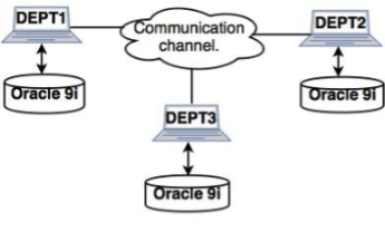
Homogeneous Database:
In a homogeneous database, all different sites store database identically. The operating system, database management system, and the data structures used all are the same at all sites. Hence, they're easy to manage.

Slide 9
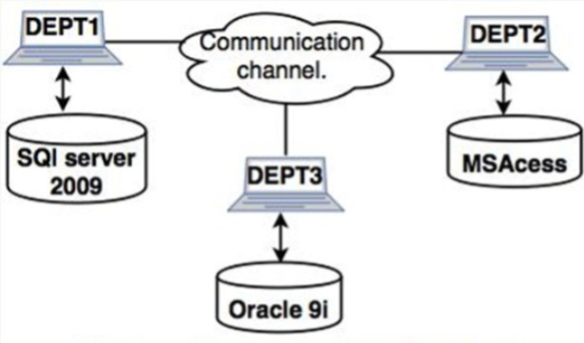
Heterogeneous Database:
Contrary to homogeneous databases, heterogeneous databases allow nodes in a distributed system to use different DBMS software or possess varying database schemas. This approach caters to diverse requirements and facilitates seamless integration between nodes employing different technologies. Let's explore the characteristics and steps involved in setting up a heterogeneous database.

Slide 10
Distributed Database Storage
Distributed database storage is managed in two ways:
Replication
Fragmentation

Slide 11
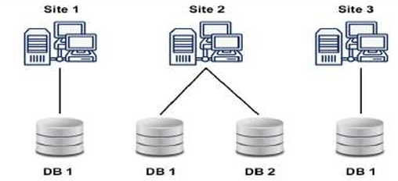
Replication
In database replication, the systems store copies of data on different sites. If an entire database is available on multiple sites, it is a fully redundant database.
• The advantage of database replication is that it increases data availability on different sites and allows for parallel query requests to be processed.

Slide 12
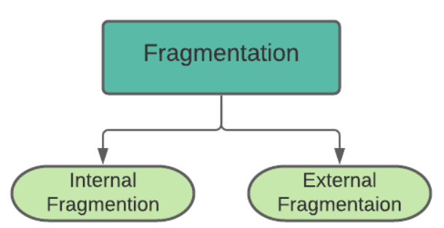
Fragmentation
When it comes to fragmentation of distributed database storage, the relations are fragmented, which means they are split into smaller parts. Each of the fragments are stored on a different site, where it is required.
The prerequisite for fragmentation is to make sure that the fragments can later be reconstructed into the original relation without losing data.

Slide 13
Issues of Distributed Databases
Costly Software. Ensuring data transparency and coordination across multiple sites often requires using expensive software in a distributed database system.
Large Overhead. Many operations on multiple sites requires numerous calculations and constant synchronization when database replication is used, causing a lot of processing overhead.
Data Integrity. A possible issue when using database replication is data integrity, which is compromised by updating data at multiple sites.

Slide 14
Centralized Database Vs Distributed Database
 | Distributed Database
In Centralized DBMS the database are stored in a only one site | In Distributed DBMS the database are stored in different site and help of network it can access it
Database is maintained at one site | Database is maintained at a number of different sites
If centralized system fails, entire system is halted | If one system fails, system continues work with other site
It is a less reliable | It is a more reliable
Centralized Database

Slide 15
Summary of the Lecture
Scalability, Availability, and Reliability:
The lecture explained how systems must grow with user demand (scalability), stay accessible without downtime (availability), and function correctly even during failures (reliability).
Monolithic vs Microservices:
We learned the difference between a single, unified application (monolith) and a collection of small, independent services (microservices), including when each approach is useful.
Latency and Throughput:
These performance metrics were discussed to understand system efficiency—latency measures response time, while throughput measures how many requests a system can handle per second.
Caching:
The lecture highlighted caching as a method to store frequently accessed data for quick retrieval, helping to reduce load on servers and speed up system performance.

Slide 16
Next Lecture
Functional vs. Non-Functional Requirements
Scaling Challenges: Horizontal vs. Vertical Scaling
Load Balancing – Principles and Deployment Strategies
Load Balancing Algorithms (RR, Weighted RR, Least Connection)

Slide 17
Quiz/ FAQ’s
1. What is the main difference between vertical and horizontal scaling?
A. Vertical scaling adds more machines; horizontal scaling increases RAM
B. Vertical scaling increases resources of one machine; horizontal scaling adds more machines
C. Both increase CPU only
D. None of the above
Correct Answer: B
2. Which component helps distribute traffic among multiple servers?
A. Cache
B. Database
C. Load Balancer
D. API Gateway
Correct Answer: C
3. What is the purpose of caching in a system?
A. To store data permanently
B. To speed up data retrieval by storing frequently accessed data
C. To replace the database
D. To improve microservices communication
Correct Answer: B

Slide 18
References/ Articles/ Videos
Book Reference:
System Design Guide for Software Professionals- Kindle Edition by Dhirendra Sinha (Author), Tejas Chopra (Author) Format
Tutorial Link:
https://www.geeksforgeeks.org/system-design/system-design-tutorial/
Video Link:
https://www.youtube.com/results?search_query=Introduction+to+System+Design
https://x.com/ShradhaKhapra_

Slide 19

Class-Wise Feedback

Slide 20
Thank You
For queries Email: kamaljeet.e19147@cumail.in

